Slide 1

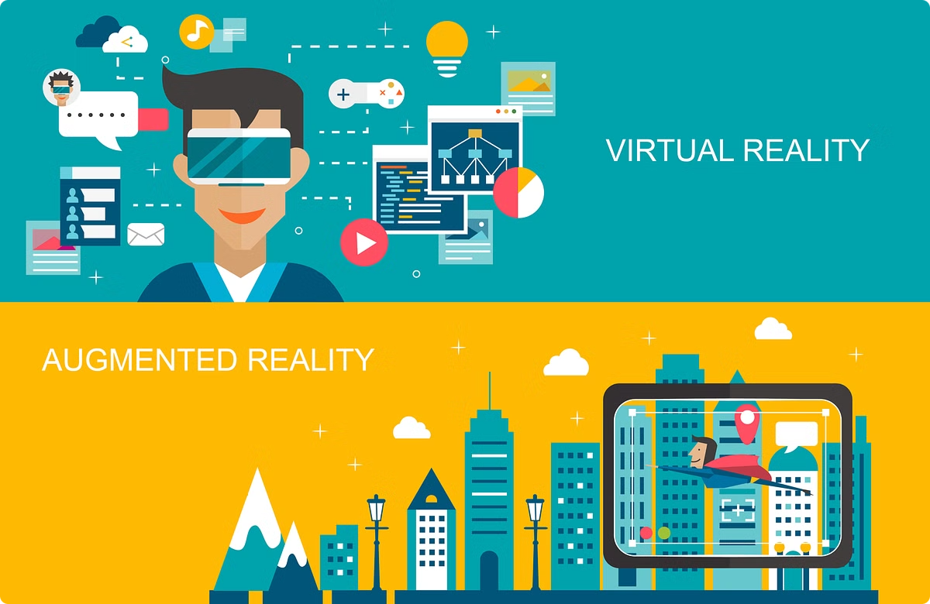
Introduction to Augmented and Virtual Reality
Augmented Reality (AR) and Virtual Reality (VR) are transformative technologies that are revolutionizing the way we interact with digital information. AR blends the digital and physical worlds, while VR immerses users in fully simulated 3D environments.
-By- Bindusree Bandi [22071A6770]

Slide 2

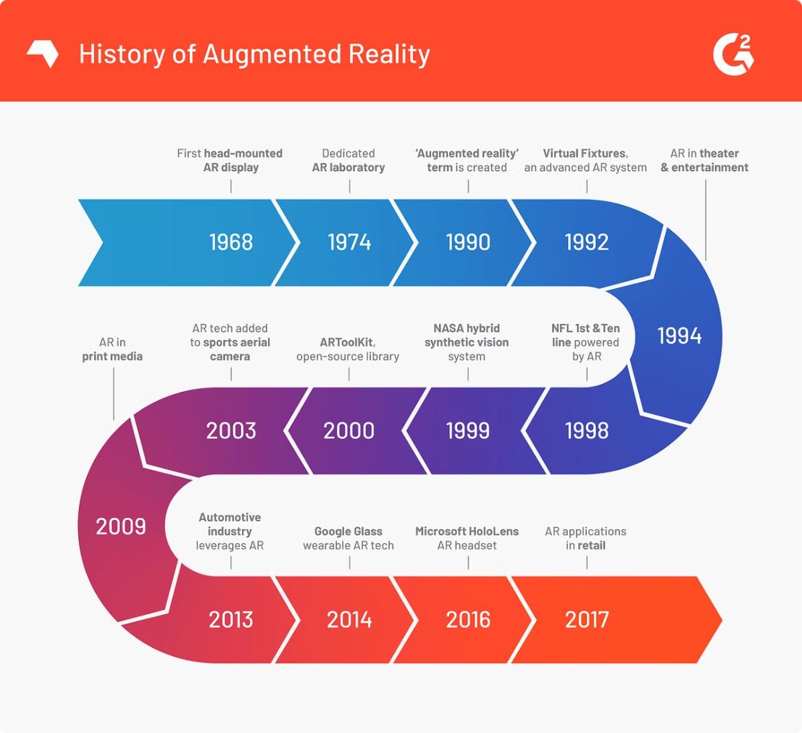
History and Evolution of AR and VR
1
1960s
The origins of AR and VR can be traced back to the 1960s, with early experiments and prototypes developed by pioneering researchers.
2
1990s
The first consumer-oriented VR headsets and AR applications started to emerge, laying the foundation for the technologies we know today.
3
2010s
Advancements in hardware, software, and processing power have led to a rapid expansion of AR and VR, with widespread adoption across various industries.

Slide 3

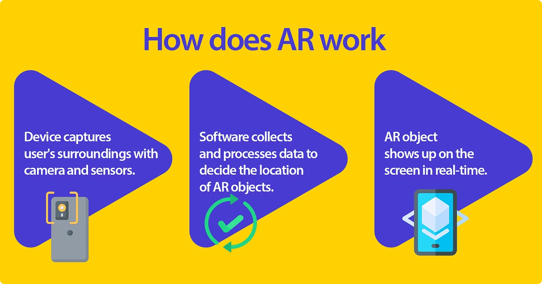
How Augmented Reality Works
Tracking and Mapping
Rendering and Display
AR systems use sensors and cameras to detect the environment and track the user's movements, allowing digital content to be seamlessly integrated.
Digital objects and information are rendered and displayed in the user's view, either through a smartphone, tablet, or specialized AR glasses.
Interaction and Engagement
Contextual Awareness
Users can interact with the AR content using touch, voice, or gestures, creating a more immersive and engaging experience.
AR systems can use location data, object recognition, and other sensors to provide relevant and personalized digital information to the user.

Slide 4
How Virtual Reality Works
Head-Mounted Displays
Motion Tracking
Spatial Audio
VR headsets use specialized displays, lenses, and sensors to create a fully immersive, 360-degree virtual environment for the user.
VR systems use a variety of sensors to track the user's head, body, and hand movements, allowing for natural interaction with the virtual world.
Surround sound and spatial audio technologies create a realistic and immersive auditory experience, further enhancing the sense of presence in the virtual environment.

Slide 5



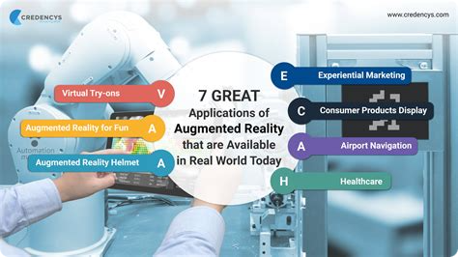


Applications of AR and VR in Various Industries
Gaming
Education
AR and VR have transformed the gaming industry, offering more immersive and interactive experiences.
These technologies are revolutionizing the way students learn, by providing interactive and engaging educational content.
Healthcare
Retail
AR and VR are being used for medical training, patient rehabilitation, and even remote surgery.
AR and VR are enhancing the shopping experience, allowing customers to virtually try on products or visualize them in their homes.

Slide 6

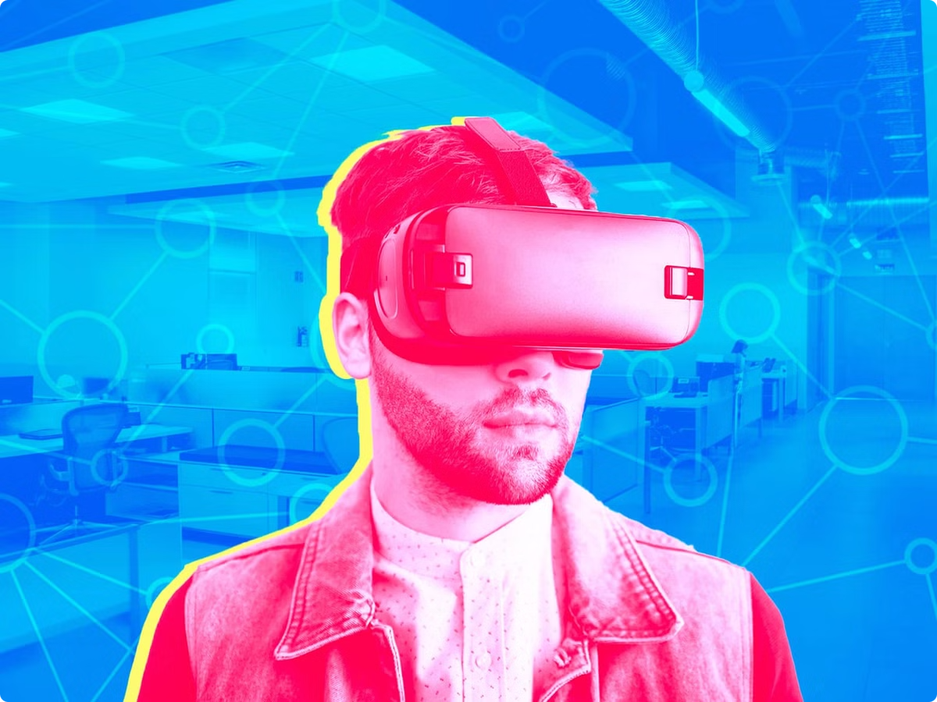
Current Market Leaders in the AR and VR Space
1
Meta (Facebook)
2
Apple
Developing the Oculus line of VR headsets and investing heavily in AR and VR technologies.
Rumored to be working on an AR/VR headset and integrating AR features into its iOS ecosystem.
3
Microsoft
4
Google
Offering the HoloLens AR headset and incorporating AR/VR capabilities into its software and services.
Developing AR platforms like ARCore and experimenting with VR through its Cardboard and Daydream initiatives.

Slide 7

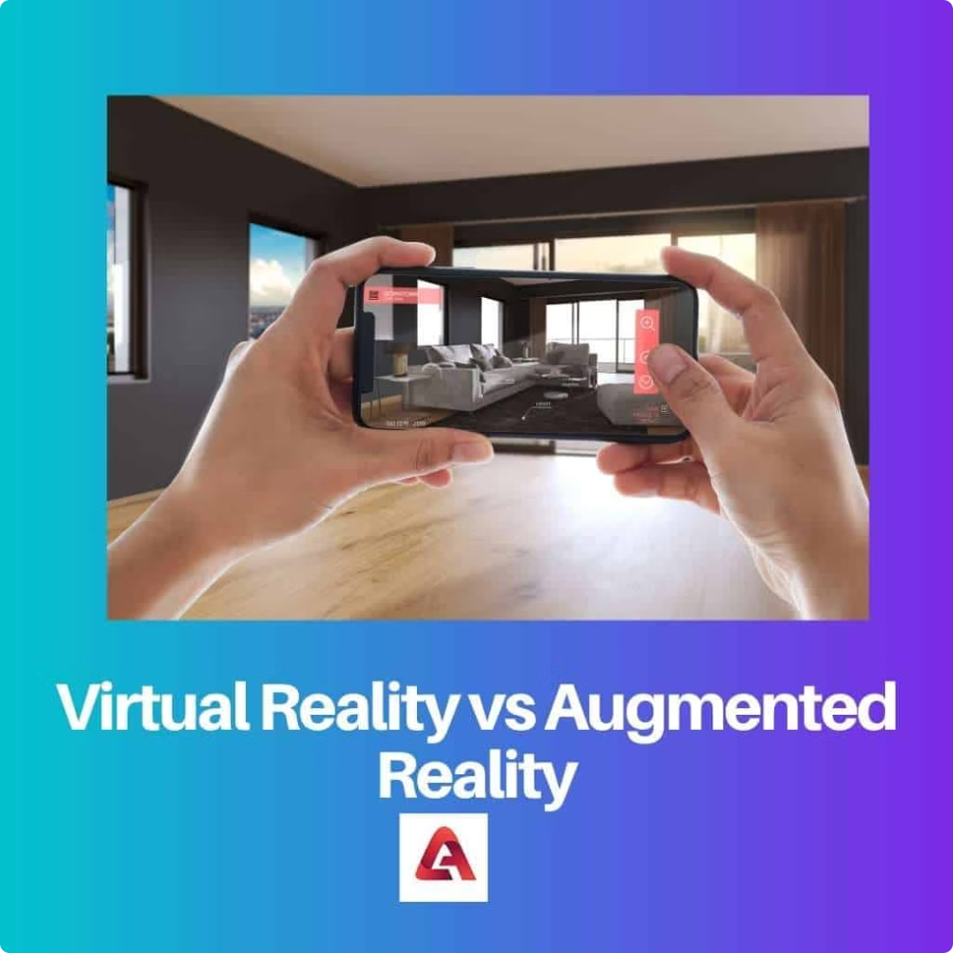



Challenges and Limitations of AR and VR Technology
Hardware Limitations
Current AR and VR headsets can be bulky, heavy, and limited in terms of battery life and processing power.
Motion Sickness
Prolonged use of VR headsets can cause motion sickness and disorientation in some users.
Social Isolation
Immersive VR experiences can disconnect users from the physical world and social interactions.

Slide 8


Future Prospects and Trends in the AR and VR Market
Advancements in Display and Tracking Technology
Lighter, more comfortable, and higher-resolution AR/VR headsets with improved motion tracking and sensor accuracy.
Improvements in Spatial Computing
Enhanced capabilities for AR and VR systems to understand and interact with the physical environment.
Increased Adoption in Enterprise and Industrial Applications
AR and VR being widely used for remote collaboration, training, and visualization in various industries.
Convergence with Other Emerging Technologies
Integration of AR and VR with artificial intelligence, 5G, cloud computing, and the Internet of Things for more seamless and intelligent experiences.

